Slide 1
DREAMers & Legal Limbo as of Jan 4, 2018
Michael Kagan
UNLV Boyd School of Law
University Student Legal Services Association-Western Region
24th Annual Continuing Legal Education Conference
January 4, 2018

Slide 2
Why DACA?
Legacy of 1986 Immigration Reform and Control Act.
EWI bar
Unlawful presence bar

Slide 3
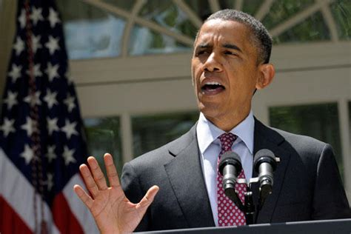
DACA 1 - 2012

Slide 4
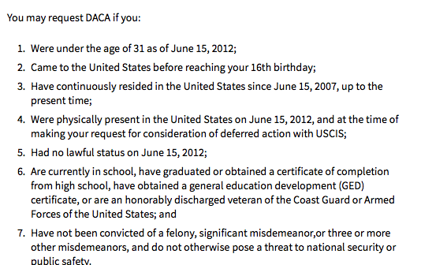
DACA 1 – 2012 (Deferred Action for Childhood Arrivals)

Slide 5
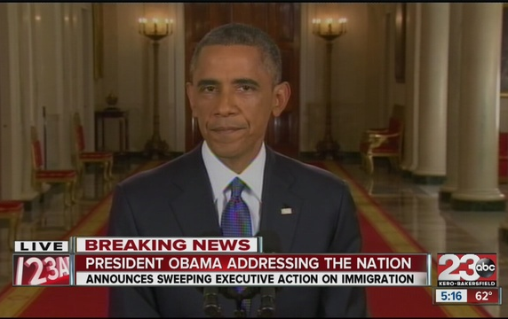
DACA 2 - 2014

Slide 6
DACA 2 - 2014
KEY CHANGE: Removal of June 1981 birth cut off.

Slide 7
DACA 2 - 2014
KEY CHANGE: Removal of June 1981 birth cut off.

Slide 8
DACA Expansion & new DAPA programs blocked in the courts
DACA 1 (original version) remained in place.
Main objections:
Lack of notice & comment (APA)
Lack of statutory authority
Preliminary injunction from Fifth Circuit in 2015; affirmed by evenly divided Supreme Court in 2016.

Slide 9
Benefits and Impact of DACA
“Deferred Action” – 2-year permits
Employment Authorization
Center for American Progress study:
69 percent reported moving to a job with better pay.
Average hourly wage reported increasing from $10.29 to $17.46.
56 percent reporting moving to a job with better working conditions.
5 percent started their own businesses (3.1 percent in general US population).
65 percent reported purchasing their first car.
16 percent purchased their first home.

Slide 10
Benefits and Impact of DACA
For students, employment and lower anxiety may be the chief benefits.
DACA recipients often become the

Slide 11
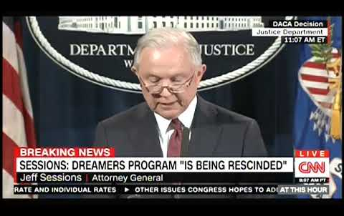
2017: End of DACA

Slide 12
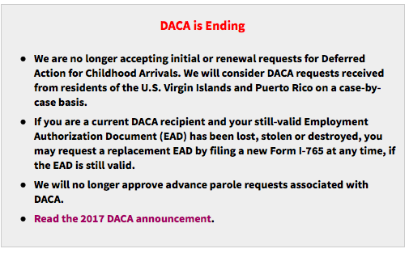
2017: End of DACA

Slide 13
2017: End of DACA
March 5, 2018

Slide 14
Alternatives to DACA
DREAMers who entered the country legally have more possibilities.
BUT: DACA was necessitated by the reality that under the INA, most doors are closed.

Slide 15
DREAM ACT, Bridge Act, Etc.
Long term v. Interim?
Path to legal permanent residency & citizenship?
CONGRESS MAY DO NOTHING.

